Slide 1

PREPARED BY:
DONABEL DE VEAS-ABUAN

Slide 2
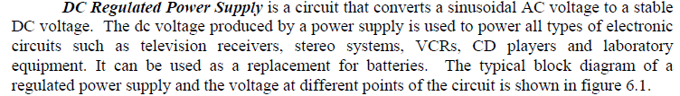
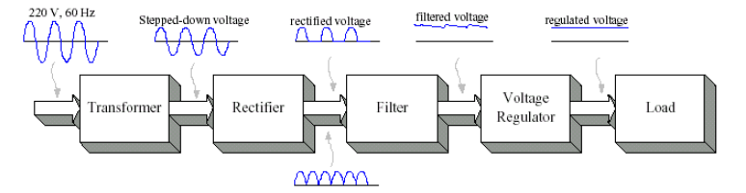

Slide 3
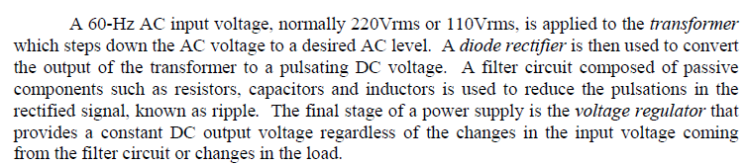

Slide 4
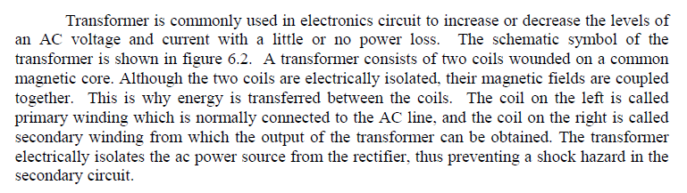
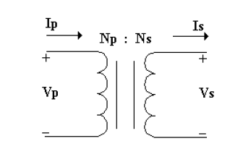

Slide 5
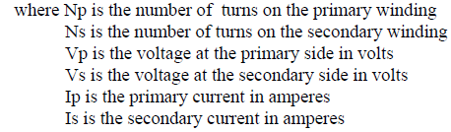

Slide 6




Slide 7
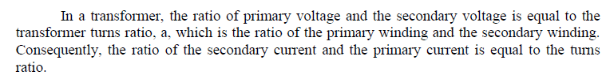

When : a>1 , Vs < Vp, Step-down transformer
a<1, Vs > Vp , Step-up transformer

Slide 8
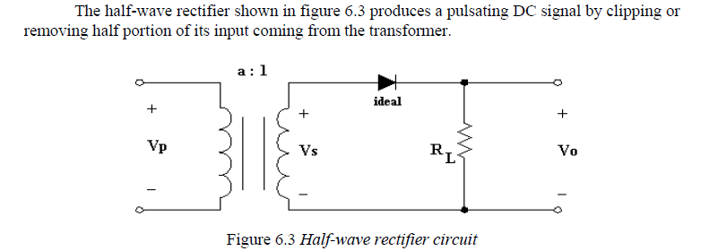
Half-wave Rectifier

Slide 9
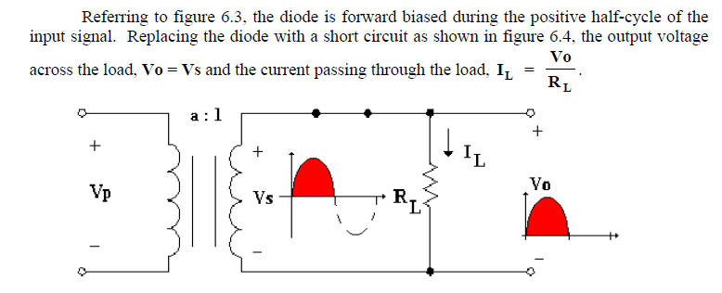
Half-wave Rectifier

Slide 10
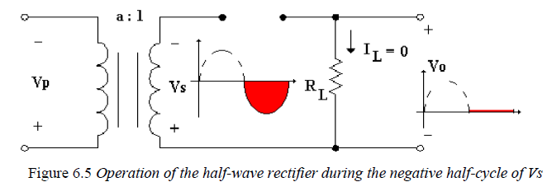
Half-wave Rectifier

Slide 11

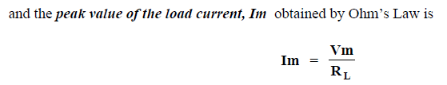
Half-wave Rectifier

Slide 12
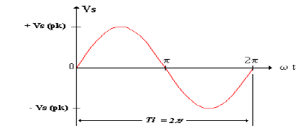
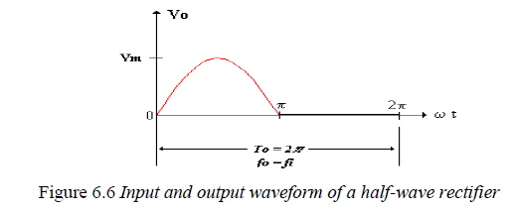
Half-wave Rectifier

Slide 13
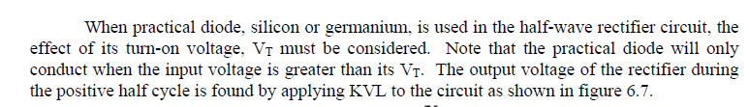
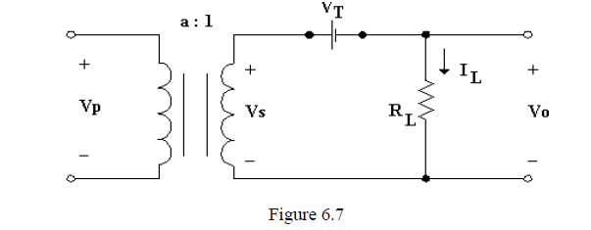

Slide 14


Slide 15


Slide 16

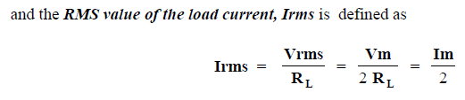
EFFECTIVE OR ROOT-MEAN-SQUARE(RMS) VOLTAGE AND CURRENT OF THE HALF-WAVE RECTIFIER

Slide 17

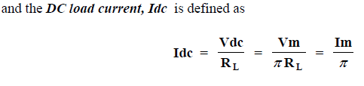
AVERAGE OR DC VOLTAGE AND CURRENT OF THE HALF-WAVE RECTIFIER

Slide 18


AC COMPONENT (RIPPLE) OF THE HALF-WAVE RECTIFIER

Slide 19
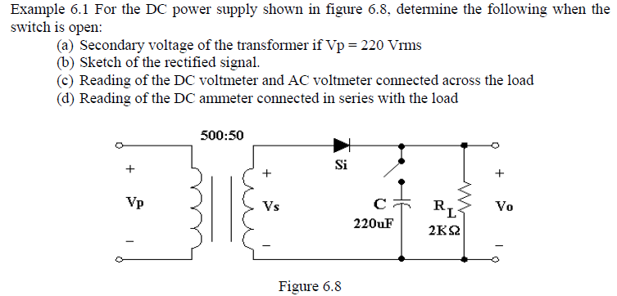

Slide 20
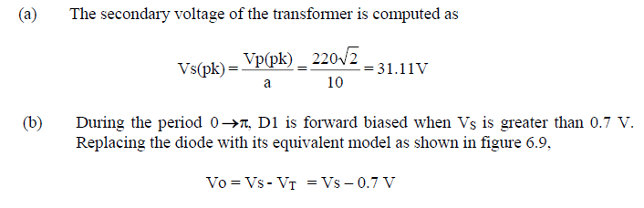
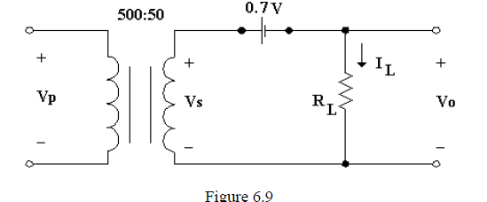
Solutions

Slide 21
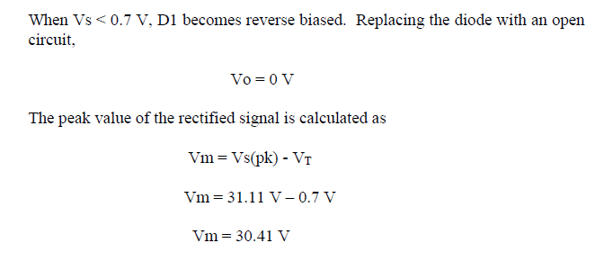
Solutions

Slide 22
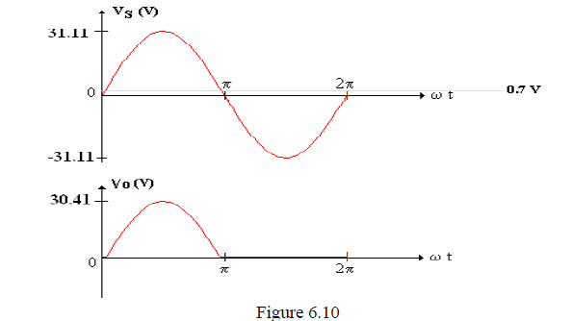
Solutions

Slide 23
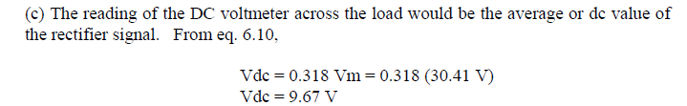
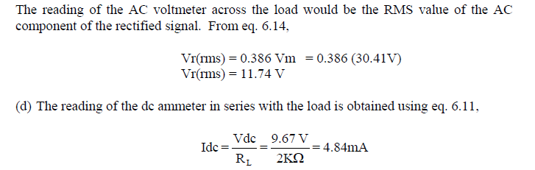
Solutions

Slide 24
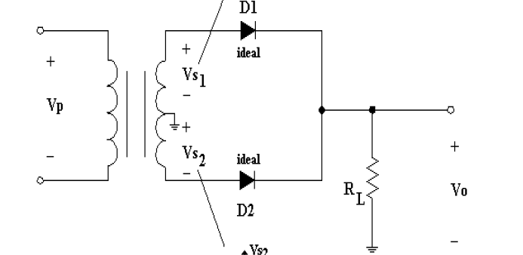
Center-tapped transformer

Slide 25
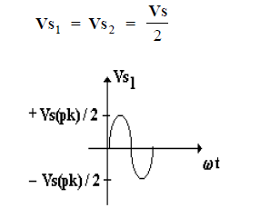
Center-tapped transformer

Slide 26
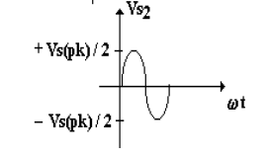
Center-tapped transformer

Slide 27
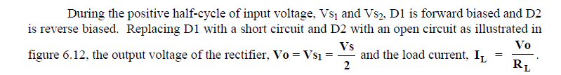
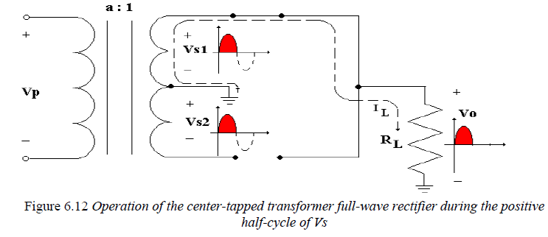

Slide 28
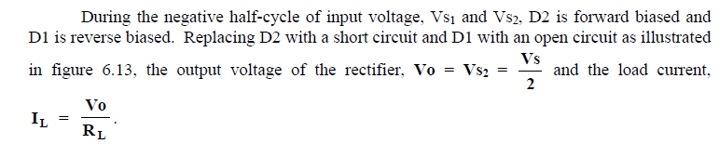
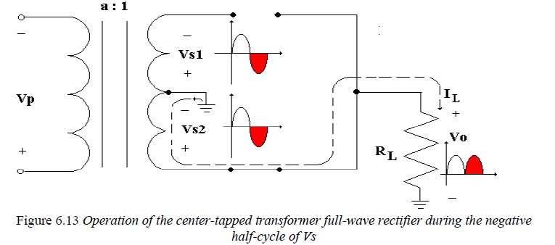

Slide 29



Slide 30
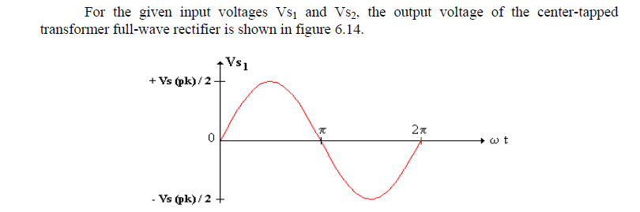
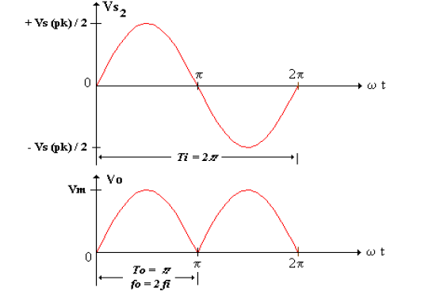

Slide 31
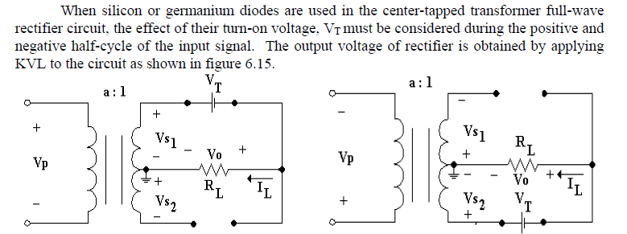
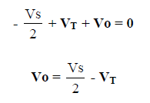

Slide 32
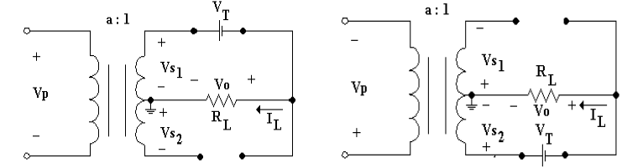


Slide 33
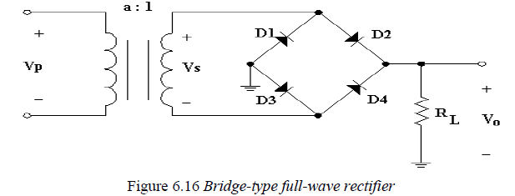
Bridge-type Full-wave Rectifier

Slide 34
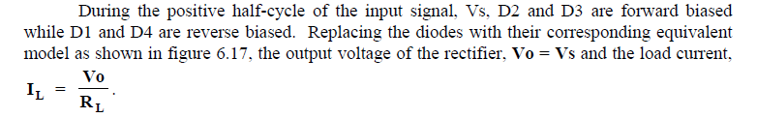
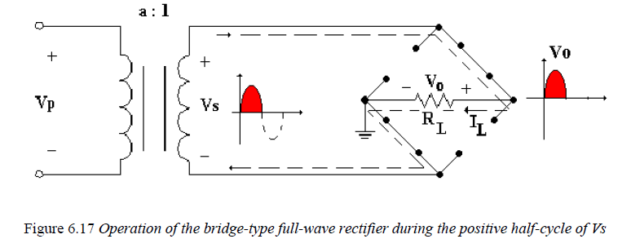

Slide 35
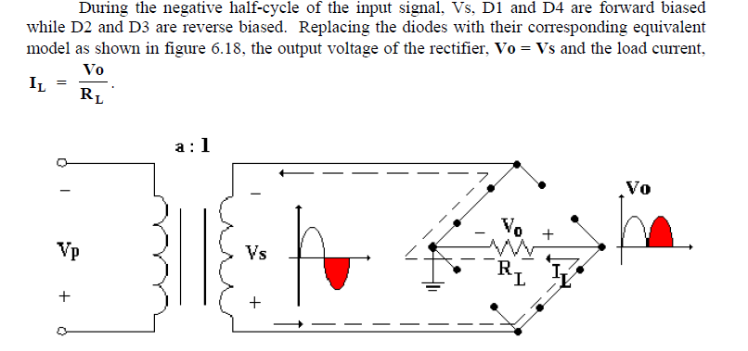

Slide 36

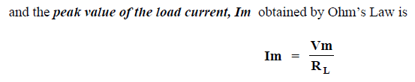
Bridge-type full-wave rectifier

Slide 37
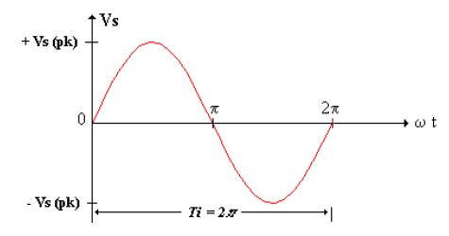
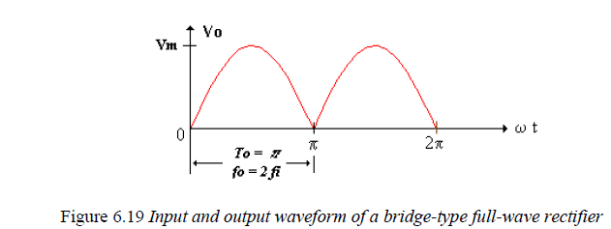

Slide 38
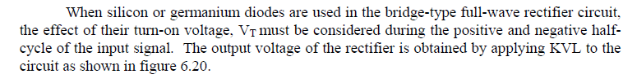
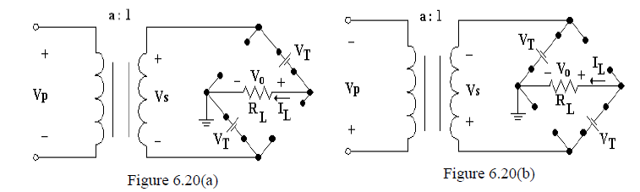

Slide 39
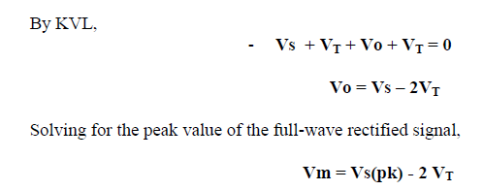

Slide 40

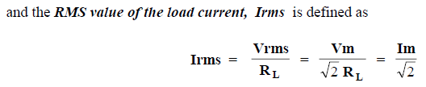
EFFECTIVE OR RMS VOLTAGE AND CURRENT OF THE FULL-WAVE RECTIFIER

Slide 41

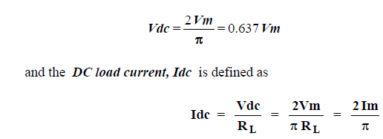
AVERAGE OR DC VOLTAGE AND CURRENT OF THE FULL-WAVE RECTIFIER

Slide 42


AC COMPONENT (RIPPLE) OF THE FULL-WAVE RECTIFIER

Slide 43
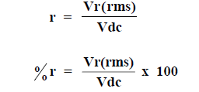
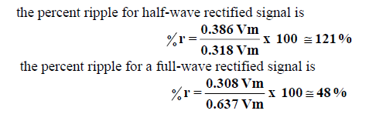
RIPPLE FACTOR OF THE RECTIFIED SIGNAL

